Slide 1


“Providing services to People with Disabilities”
A presentation by
Teresa O Boyle / Tina Doogan
Local Services Managers – Sligo,
Leitrim & Donegal.
A presentation by
Teresa O Boyle / Tina Doogan
Local Services Managers – Sligo,
Leitrim & Donegal.

Slide 2

Mission Statement
To Enable People with an Acquired Brain Injury to live an independent life in the community by providing and maintaining a supported living environment.

Slide 3
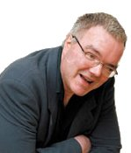
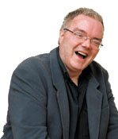
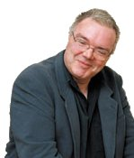
Peter Bradley

Slide 4
Philosophy
Acquired Brain Injury Ireland is driven by the ethos of maximising ability, and the person is at the centre of everything we do. We strongly promote :
Dignity,
Respect,
Choices,
Sharing ordinary places ,
Contribution & Relationships.

Slide 5
Type of Service
Residential & Community based rehabilitation following an Acquired Brain Injury.
Typical Clients are aged between 18 – 65 years
Specific expertise is cognitive Rehabilitation which includes functional independence, Emotional , Behavioural, Social and Vocational adjustment post injury.
Acquired Brain Injury Ireland work in partnership with the HSE and other Agencies.

Slide 6
ABI Services in Sligo Leitrim West Cavan & Donegal
Case Management
Community Rehabilitation Programme
Transitional Living Unit – Sligo / Leitrim
Family Support Programme
Leisure and Lifestyle Programme / Social Club
Rehabilitative Training – Training Occupational Support Services T.O.S.S. – HSE
Community Outreach/ HSE Home Help / IWA / C.I.L.
Support Groups - N.W. Stroke Group / ABI Support Group / BRI
Long term Services Day Services / Vocational Services i.e. IWA, NLN, RehabCare, LAPWD, Sligo Sports Partnership.
Residential - Nursing Homes, HSE Continuing care facilities .

Slide 7
What is an Aquired Brain Injury ?
Trauma due to head injury ( car accident, Assault, Fall,)
Post Surgical damage, following tumour removal
Vascular Accident – Stroke, Sub–arachnoid haemorrhage
Cerebral Anoxia
Other toxic or metabolic insult (e.g. Hypoglycaemia)
Infection, e.g. Meningitis, encephalitis

Slide 8

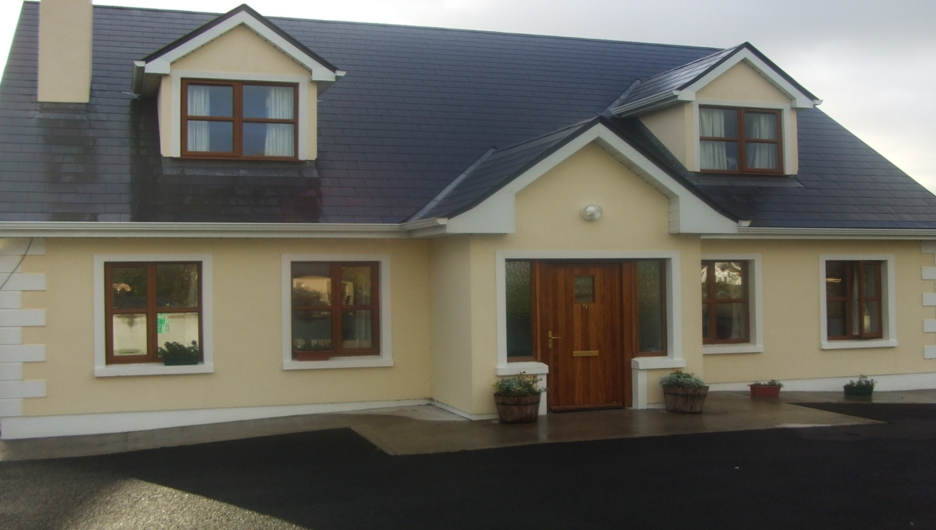
Sligo / Leitrim & West Cavan
Transitional Living Unit
2 Race Court Manor,
Tonaphubble, Sligo.

Slide 9
Community Brain Injury Service
Sligo / Leitrim Team
HSE P&S Disabilities Manager – Mary Henry
ABII Regional Manager – Steve Orme .
LSM – ABIIreland – Teresa O Boyle
Case Co Ordinator – HSE - Phil Mc Goldrick
Clinical Psychologist - ABIIreland – Dr. Caroline Mc Grath.
Senior O.T. - HSE - Rose Mary Dillon
Assistant Psychologist – Emma Daly
Team of 6 Rehabilitation Assistants - ABIIreland

Slide 10
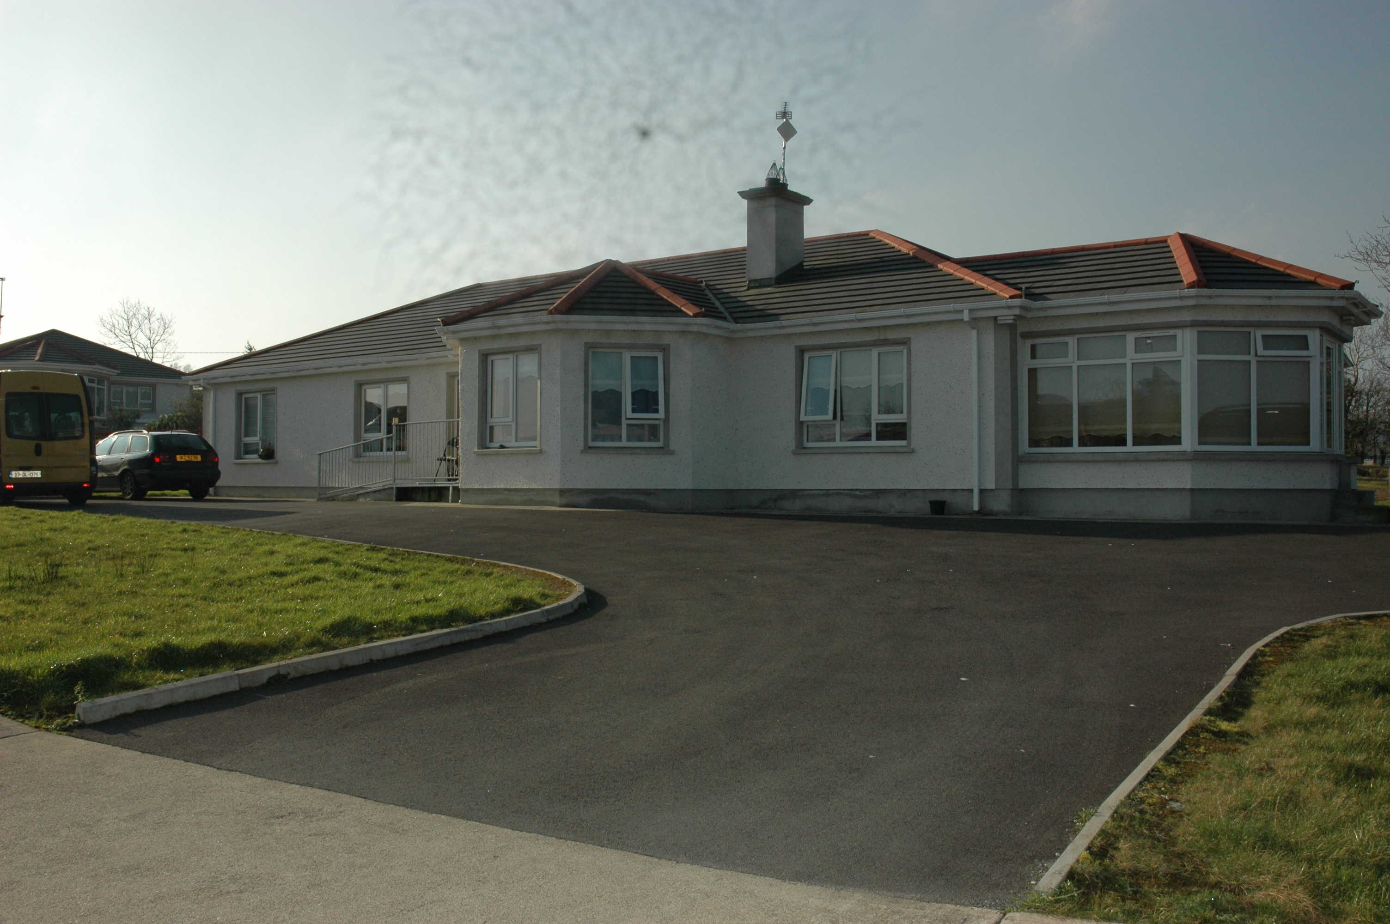
Donegal Residential Service.
2 Rough Park, Woodlands, Letterkenny, Co Donegal.

Slide 11
Community Brain Injury Service
Donegal Team
ABII Regional Manager – Steve Orme .
HSE P&S Disabilities Manager – Denise Curran
LSM, Acquired Brain Injury Ireland- Tina Doogan
ABI Keyworkers – HSE - Marie Bradley / John Cardin
Clinical Psychologist - ABII – Dr.Mark Hogan.
Senior O.T. - HSE - Judith Tait
Community Outreach Rehabilitation assistant
Team of 9 Rehabilitation Assistants - ABIIreland

Slide 12
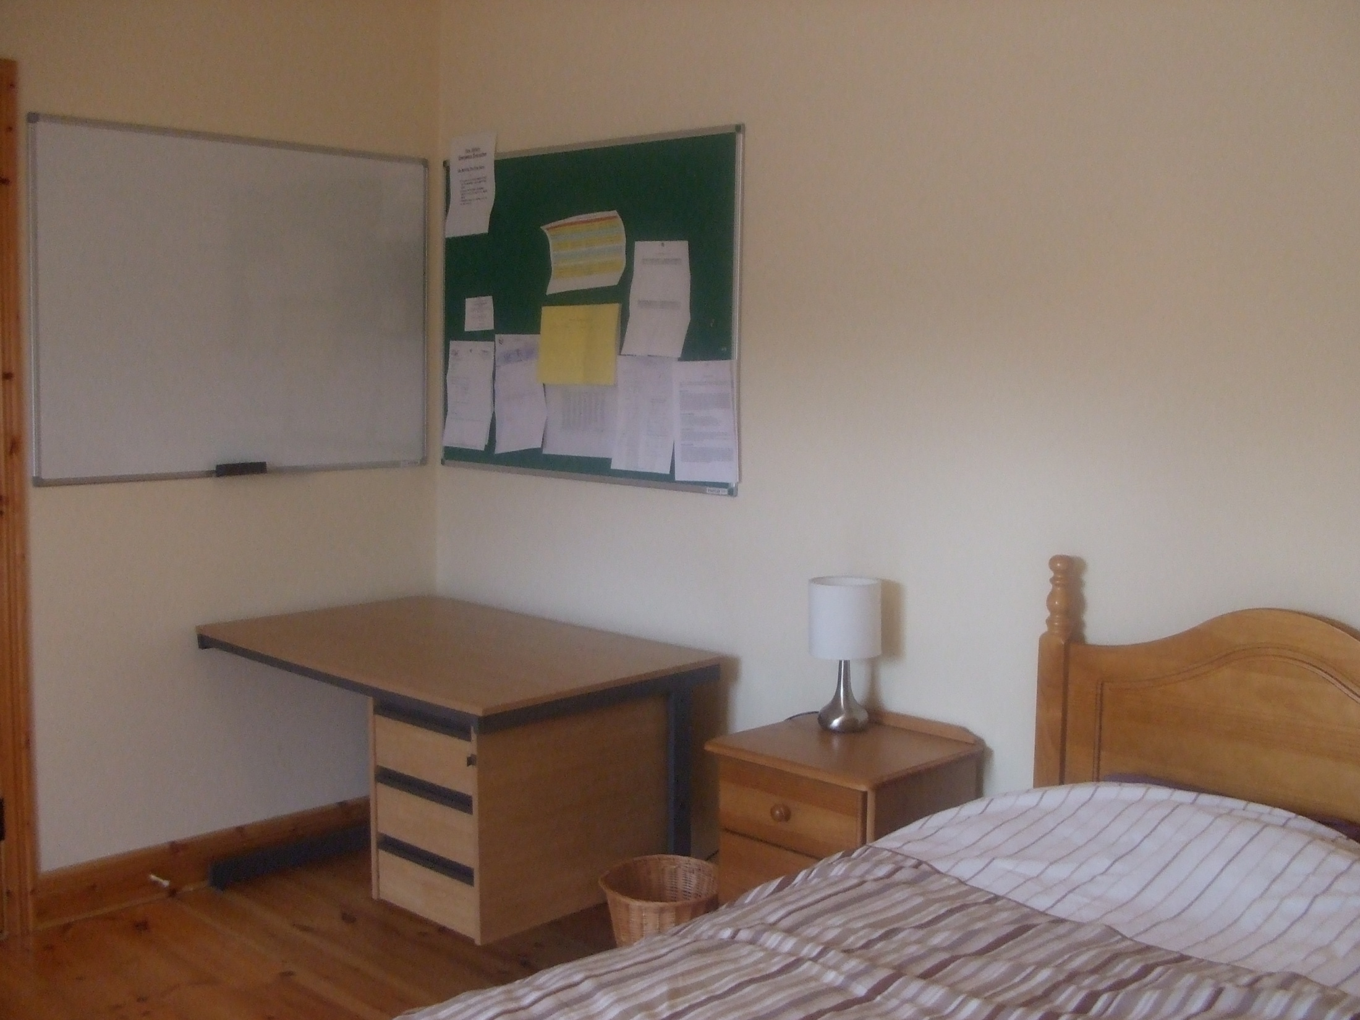

Slide 13
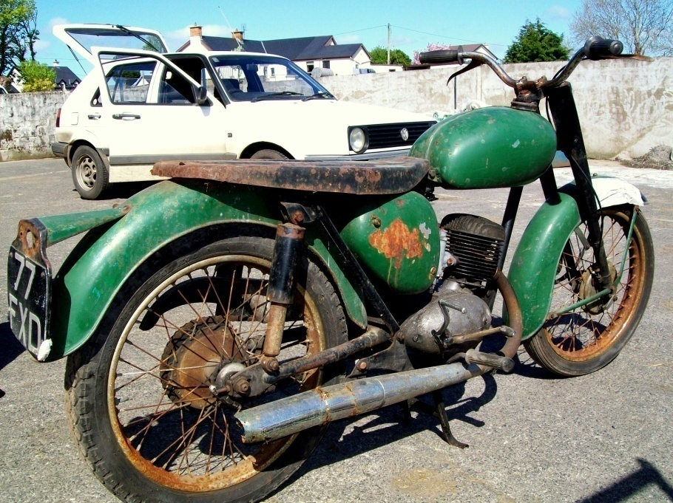
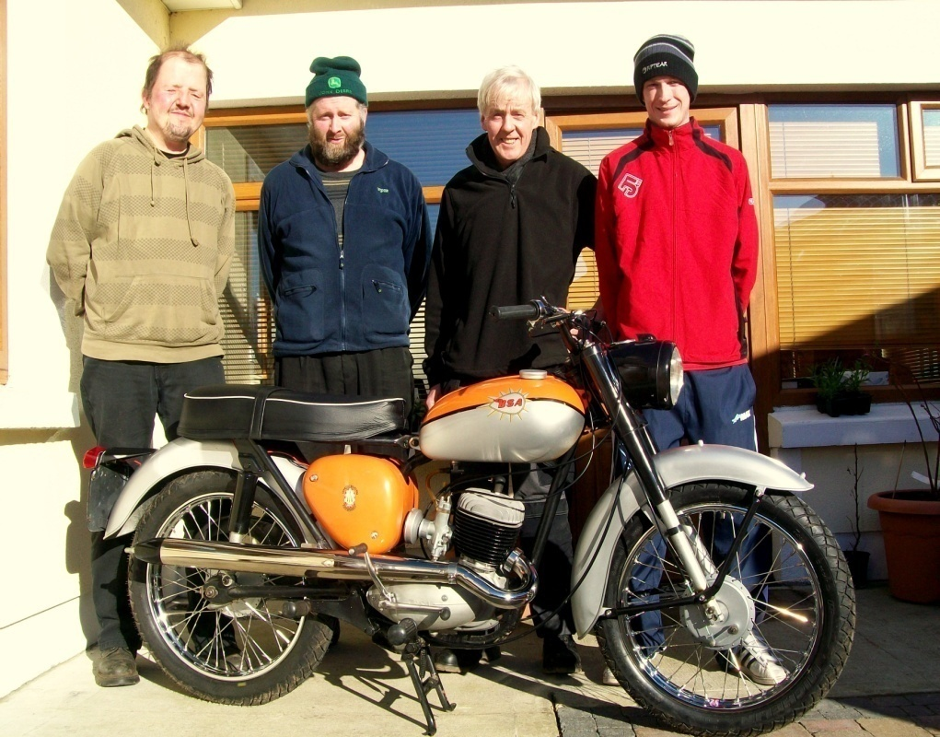
Motor cycle project

Slide 14
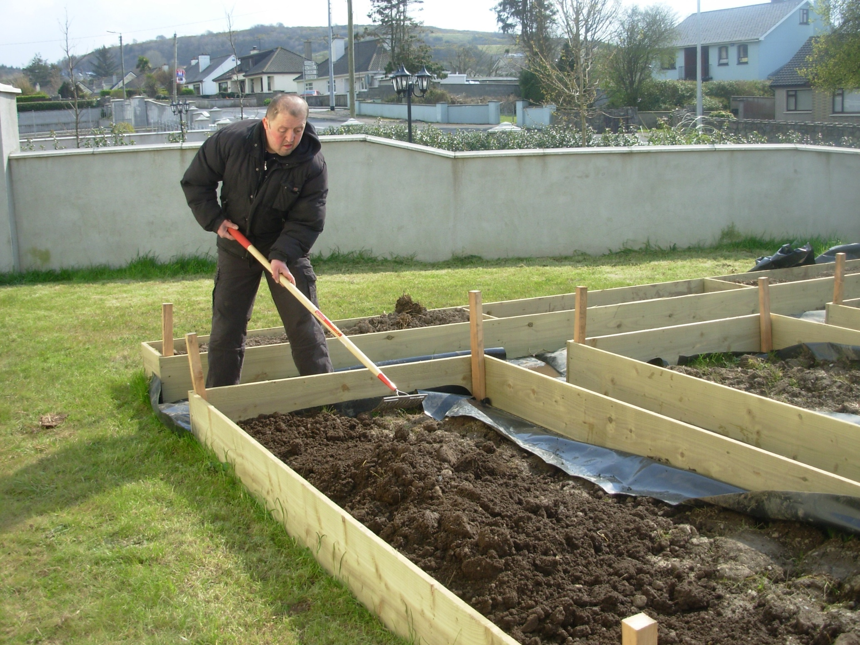

Slide 15
Contact Details
Acquired Brain Injury Ireland,
43 Northumberland Ave, Dunlaoghaire, Co Dublin.
Tel: 01 2804164, info@abiireland.ie
Donegal Service
2 Rough park, Woodlands, Letterkenny, Co Donegal.
Tel: 074 9176902,
Tina Doogan: 0871348941 / tdoogan@abiireland.ie
Sligo Service
2 Racecourt Manor, Tonaphubble, Co Sligo.
Tel: 071 9153472
Teresa O Boyle: 087 2601827 / toboyle@abiireland.ie

Slide 16

Thank You,
Teresa O Boyle, Local Services Manager Sligo
Tina Doogan , Local Services Manager, Donegal.

